Slide 1
Reinforcement Learning for NLP
Caiming Xiong
Salesforce Research CS224N/Ling284

Slide 2
Outline
Introduction to Reinforcement Learning
Policy-based Deep RL Value-based Deep RL Examples of RL for NLP

Slide 3


What is RL?
RL is a general-purpose framework for sequential decision-making
Usually describe as agent interacting with unknown environment
Goal: select action to maximize a future cumulative reward
Action 𝑎
Reward 𝑟, Observation 𝑜
Agent
Environment

Slide 4
State
Experience is a sequence of observations, actions, rewards
The state is a summary of experience

Slide 5
RL Agent
Major components:
Policy: agent’s behavior function
Value function: how good would be each state and/or action
Model: agent’s prediction/representation of the environment

Slide 6


Policy
A function that maps from state to action:
Deterministic policy:
Stochastic policy:

Slide 7
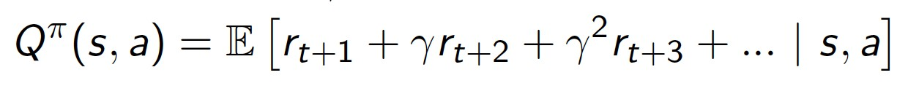
Value Function
𝐵𝑄^{𝜋} 𝑠, 𝑎 =
Q-value function gives expected future total reward
from state and action (𝑠, 𝑎)
under policy 𝜋
with discount factor 𝛾 ∈ (0,1)
Show how good current policy
Value functions can be defined using Bellman equation
Bellman backup operator
B^{𝜋}Q s, a = E₆𝘍_{,8}𝘍 [r + 𝛾𝑄^{𝜋}(𝑠<, 𝑎<)|𝑠, 𝑎]

Slide 8
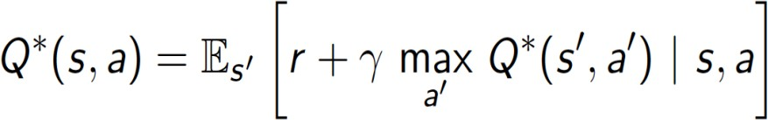
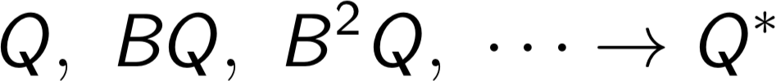
Value Function
For optimal Q-value function 𝑄∗ 𝑠, 𝑎
= max 𝑄^{𝜋}(𝑠, 𝑎) , then policy function is
𝜋
deterministic, the Bellman equation becomes:
B^{𝜋}Q s, a = E₆𝘍 [r + 𝛾 max 𝑄^{𝜋}(𝑠<, 𝑎<)|𝑠, 𝑎]
_{𝑎}𝘍

Slide 9
What is Deep RL?
Use deep neural network to approximate
Policy
Value function
Model
Optimized by SGD

Slide 10
Approaches
Policy-based Deep RL
Value-based Deep RL
Model-based Deep RL

Slide 11
Deep Policy Network
Represent policy by deep neural network that
max 𝐸_{𝑎~𝑝(𝑎|C,𝑠)}[𝑟(𝑎)|𝜃, 𝑠]
C
Ideas: given a bunch of trajectories,
Make the good trajectories/action more probable
Push the actions towards good actions

Slide 12
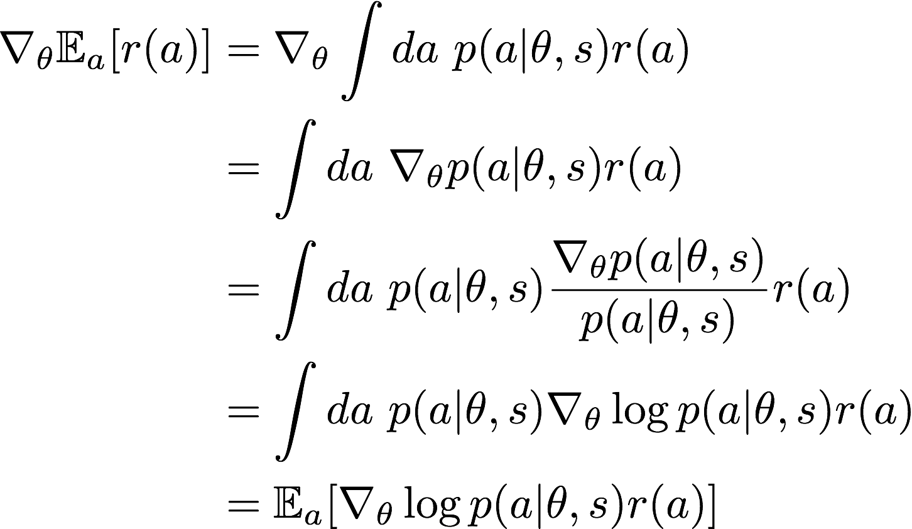
Policy Gradient
How to make high-reward actions more likely:

Slide 13

Let's 𝑟 𝑎 say that measures how good the sample is.
Moving in the direction of gradient pushes up the probability of the sample, in proportion to how good it is.

Slide 14
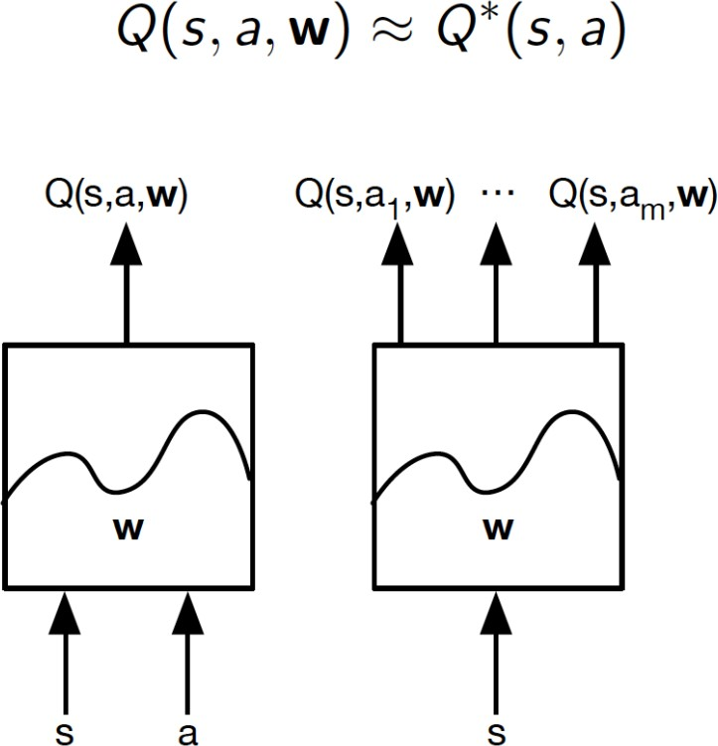
Deep Q-Learning
Represent value function by Q-network

Slide 15
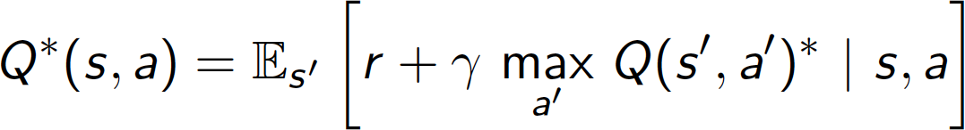
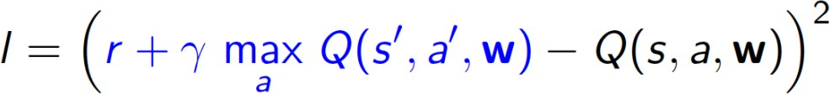
Deep Q-Learning
Optimal Q-values should obey Bellman equation
Treat right-hand side as target network, given 𝑠, 𝑎, 𝑟, 𝑠< , optimize MSE loss via SGD:
Converges to optimal Q using table lookup representation

Slide 16
Deep Q-Learning
But diverges using neural networks due to:
Correlations between samples
Non-stationary targets

Slide 17
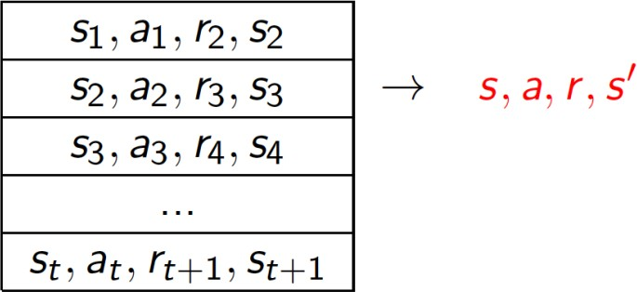
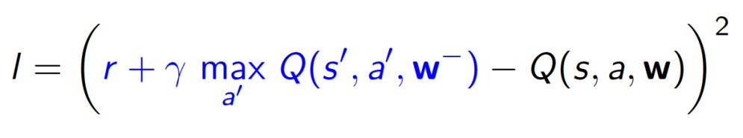
Deep Q-Learning
Experience Replay: remove correlations, build data-set from agent's own experience
Sample experiences from data-set and apply update
To deal with non-stationarity, target parameters is fixed

Slide 18
RL in NLP
Article summarization
Question answering
Dialogue generation
Dialogue System
Knowledge-based QA
Machine Translation
Text generation

Slide 19
Article Summarization
Text summarization is the process of automatically generating natural language summaries from an input document while retaining the important points.
extractive summarization
abstractive summarization

Slide 20
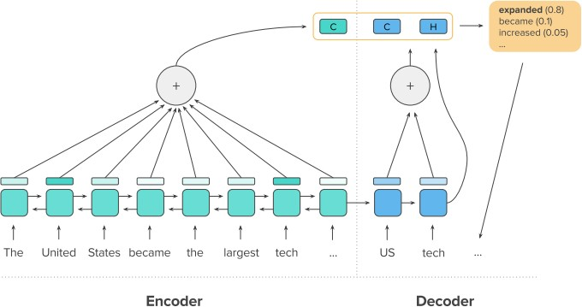
A Deep Reinforced Model for Abstractive Summarization
Given x = {𝑥_{L}, 𝑥_{M} , ⋯ , 𝑥_{𝑛}} represents the sequence of input (article) tokens, 𝑦 =
{𝑦_{L}, 𝑦_{M}, ⋯ , 𝑦_{𝑚}}, the sequence of output (summary) tokens
Coping word
Generating word
Paulus et. al.
Paulus, Romain et al. “A Deep Reinforced Model for Abstractive Summarization.” ICLR 2018

Slide 21
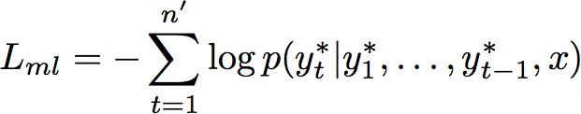
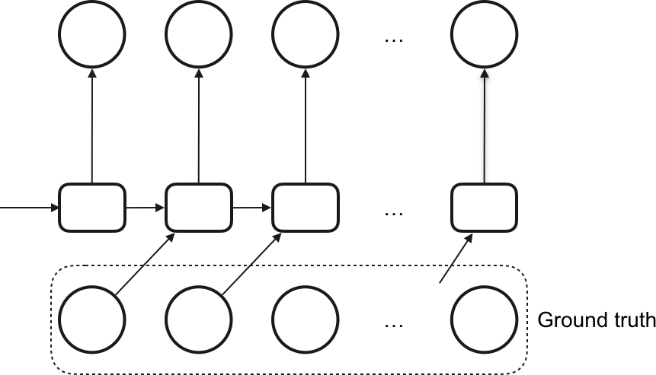
A Deep Reinforced Model for Abstractive Summarization
The maximum-likelihood training objective:
Training with teacher forcing algorithm.
Paulus et. al.

Slide 22
A Deep Reinforced Model for Abstractive Summarization
There is discrepancy between training and test performance, because
exposure bias
potentially valid summaries
metric difference
Paulus et. al.

Slide 23

A Deep Reinforced Model for Abstractive Summarization
Using reinforcement learning framework, learn a policy that maximizes a specific discrete metric.
Action: 𝑢_{𝑡} ∈ 𝑐𝑜𝑝𝑦, 𝑔𝑒𝑛𝑒𝑟𝑎𝑡𝑒 and word 𝑦^{𝑠}
𝑡
State: hidden states of encoder and previous outputs
Reward: ROUGH score
Where 𝑝 𝑦^{𝑠} 𝑦^{𝑠}, ⋯ , 𝑦^{𝑠} , 𝑥 = 𝑝 𝑢_{𝑡} = 𝑐𝑜𝑝𝑦 𝑝 𝑦^{𝑠} 𝑦^{𝑠}, ⋯ , 𝑦^{𝑠} , 𝑥, 𝑢_{𝑡} = 𝑐𝑜𝑝𝑦
𝑡 L 𝑡[L 𝑡 L 𝑡[L
+𝑝 𝑢_{𝑡} = 𝑔𝑒𝑛𝑒𝑟𝑎𝑡𝑒 𝑝(𝑦^{𝑠}|𝑦^{𝑠}, ⋯ , 𝑦^{𝑠} , 𝑥, 𝑢_{𝑡} = 𝑔𝑒𝑛𝑒𝑟𝑎𝑡𝑒)
𝑡 L
𝑡[L
Paulus et. al.

Slide 24
RL in NLP
Article summarization
Question answering
Dialogue generation
Dialogue System
Knowledge-based QA
Machine Translation
Text generation

Slide 25
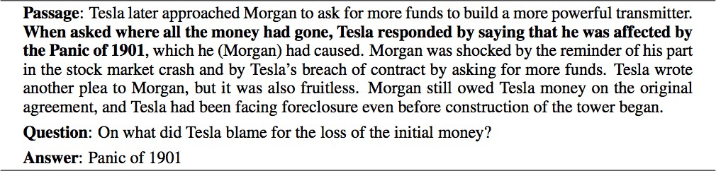
Text Question Answering
Example from SQuaD dataset

Slide 26
Text Question Answering
Loss function layer
Cross Entropy
Decoder Pointer
LSTM + MLP GRU + MLP
Self-attention biAttention Coattention
Attention Layer
Encoder Layer
Encoder Layer
LSTM, GRU
P
Q

Slide 27
DCN+: MIXED OBJECTIVE AND DEEP RESIDUAL COATTENTION FOR QUESTION ANSWERING
Constraints of Cross-Entropy loss:
P: “Some believe that the Golden State Warriors team of 2017 is one of the greatest teams in NBA history,…”
Q: “which team is considered to be one of the greatest teams in NBA history”
GT: “the Golden State Warriors team of 2017”
Ans1: “Warriors” Ans2: “history”
Xiong, C., Zhong, V. and Socher, R. DCN+: Mixed Objective And Deep Residual Coattention for Question Answering. ICLR 2018.

Slide 28

DCN+: MIXED OBJECTIVE AND DEEP RESIDUAL COATTENTION FOR QUESTION ANSWERING
To address this, we introduce F1 score as extra objective combining with traditional cross entropy loss:
Not necessary for variable length.
Xiong et. al.

